Slide 1





Mobile App Development Frameworks
Group 15 Submitted To: Dr. ONAIZA MAQBOOL
Presented By: Ahmad Masood (Leader) M. Ahmad Hassan M. Waleed Talha Arif Wains

Slide 2



Xamarin
Background and Purpose
Founded in 2011 by Mono creators, Xamarin was designed to solve the challenge of building native mobile apps across Android, iOS, and Windows without duplicating code.
Before Xamarin, developers maintained separate codebases for each platform, increasing time and costs.

Slide 3


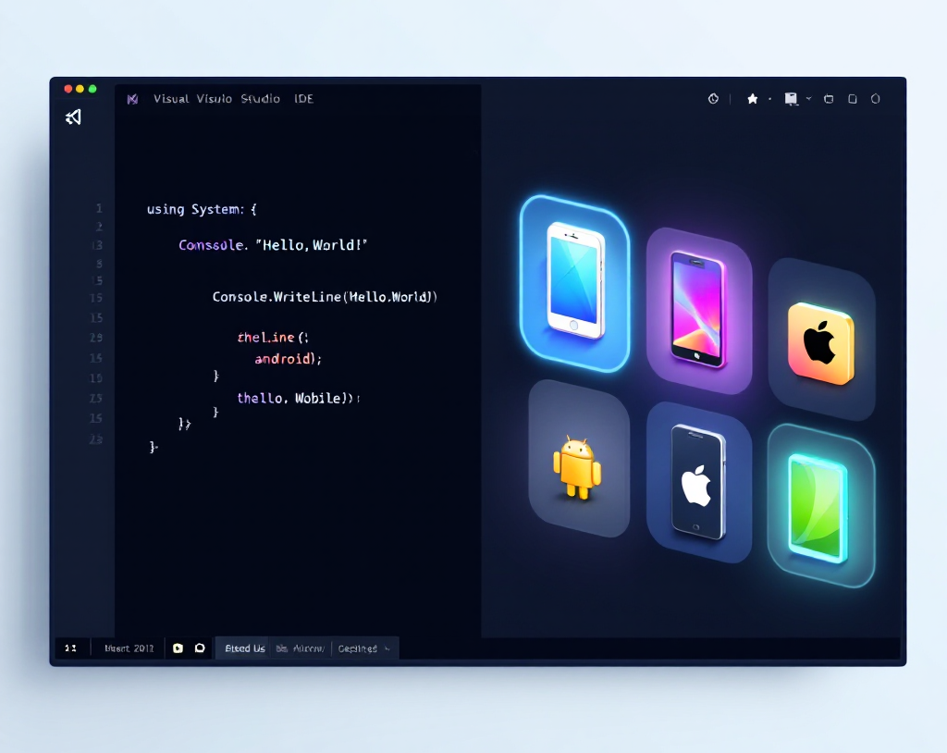


Xamarin: Tools and Languages
1
Primary language: C# using the .NET framework
2
Development environment: Microsoft Visual Studio
3
Access to native Android and iOS SDKs via bindings

Slide 4
Up to 90% code sharing across platforms
Cost-effective single codebase
Xamarin: Key Features
Native performance with direct API access
Supports third-party libraries (Java, Objective-C, C++)
Large developer community and open-source support
Integrated testing and debugging with Visual Studio App Center

Slide 5

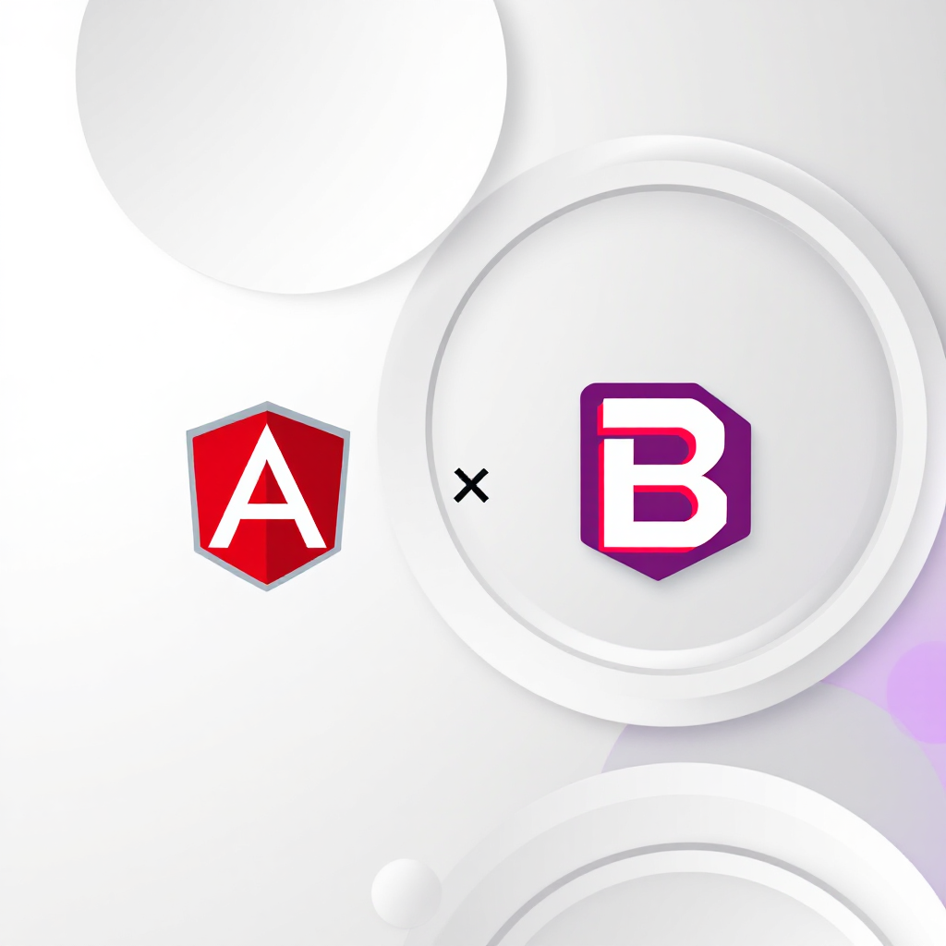
Mobile Angular UI
Background and Purpose
Using Mobile Angular UI, developers could easily build responsive, interactive mobile interfaces by combining AngularJS and Bootstrap, all without relying on jQuery.
Before Mobile Angular UI, creating mobile-friendly web apps was difficult with Bootstrap alone, as it lacked essential mobile components and touch support.

Slide 6


Built with AngularJS (JavaScript) and Bootstrap (CSS)
Mobile Angular UI: Tools and Features
1
No jQuery dependency for lightweight apps
2
Responsive design adapting to screen sizes
3
Built with AngularJS (JavaScript framework) and Bootstrap (CSS framework).
Includes fastclick.js and overthrow.js for better mobile experience

Slide 7
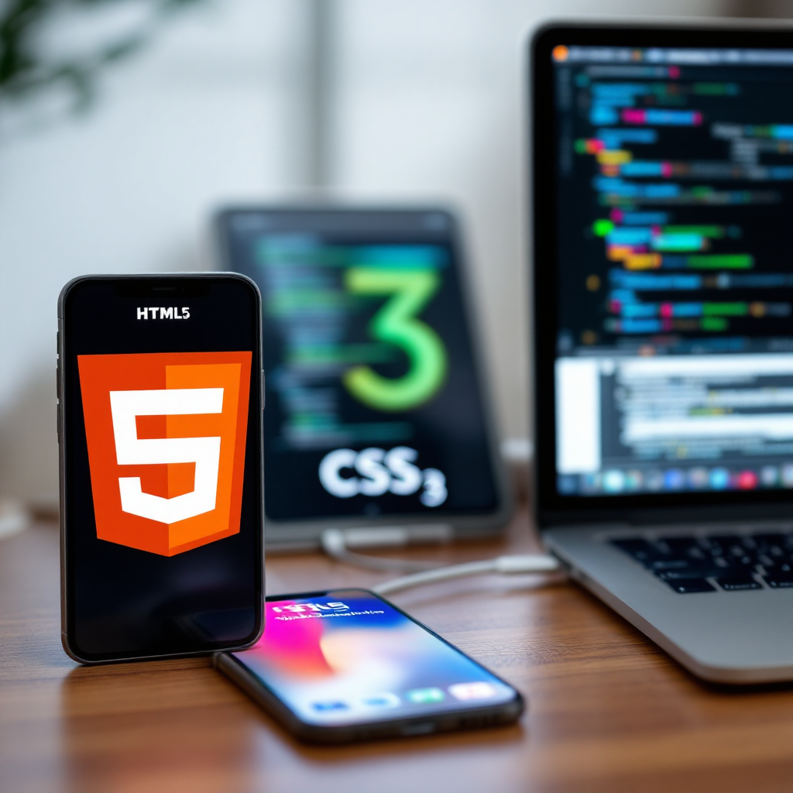

Adobe PhoneGap
Background and Purpose Acquired by Adobe in 2011, PhoneGap enables web developers to build mobile apps using HTML5, CSS3, and JavaScript.
It bridges web technologies with native device features, lowering the barrier for cross-platform app development.

Slide 8
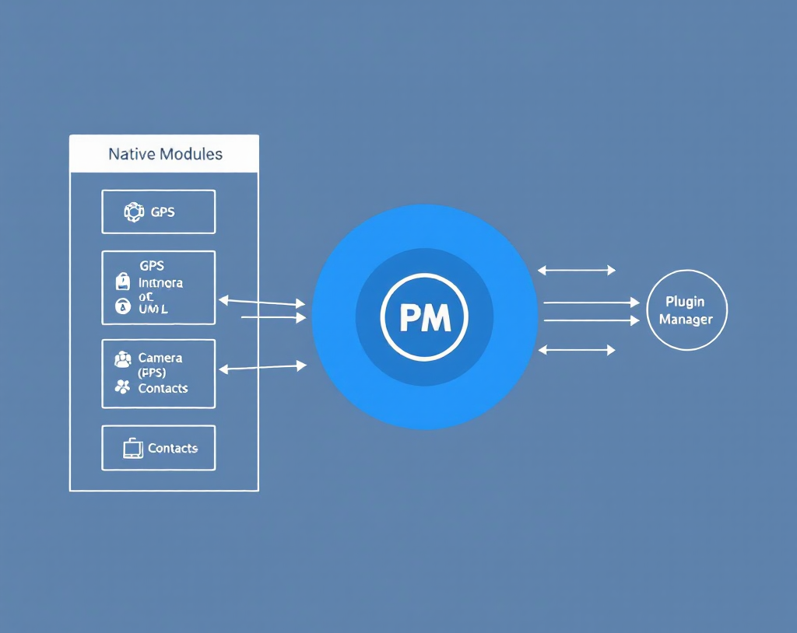
Adobe PhoneGap: Tools and Key Features
1
Uses standard web technologies with plugin access to native features
2
Code reusability: write once, deploy everywhere
3
Supports all major mobile OS with no hardware restrictions

Slide 9





Summary: Framework Comparison
Xamarin: Native apps with shared C# codebase, strong community, and native performance
Mobile Angular UI: Responsive mobile web apps using AngularJS and Bootstrap without jQuery
Adobe PhoneGap: Web technology-based apps with plugin access to native device features

Slide 10

THANK
YOU!

Slide 11
References
https://fullscale.io/blog/xamarin/
https://www.codementor.io/@justinauch/what-is-xamarin-and-why-do-we-use-it-fksh6xr9c
https://www.tutorialspoint.com/mobile_angular_ui/mobile_angular_ui_quick_guide.html
https://pro.okebajo.com/the-ultimate-guide-to-adobe-phonegap-everything-you-need-to-know/

